Slide 1
CASE 1.:THE GREBBELINIE, a Dutch military defence line
After studying this case you:
• Have more knowledge of the Grebbelinie as a tourism example of a (living) heritage
• Are able to describe the importance of historical defence lines in EU perspective
• Can use the case as an example how to relate tourism and “living” defence lines and castles.

Slide 4
History

Slide 5
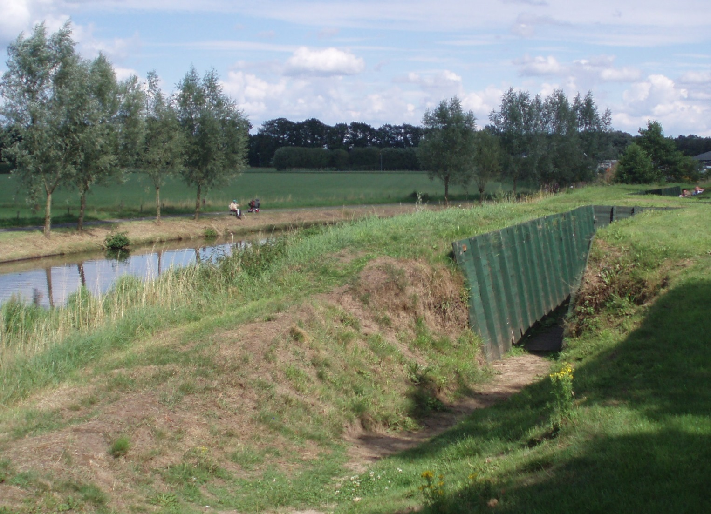
Trenches

Slide 6
Trench

Slide 9
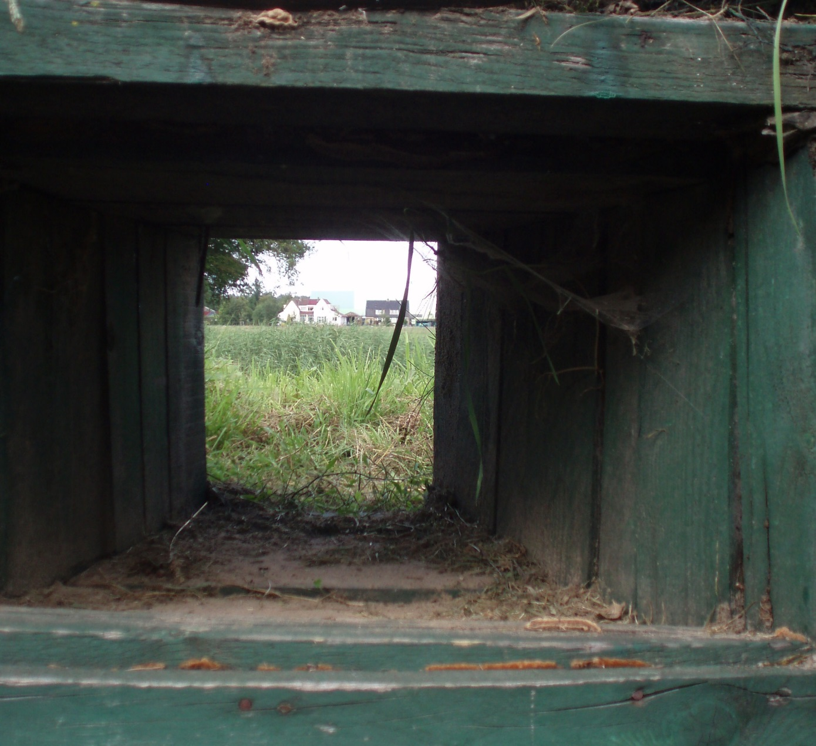
Machine-gun port

Slide 10
Bunker

Slide 11
Bunker

Slide 12
Anti tank blockade

Slide 13
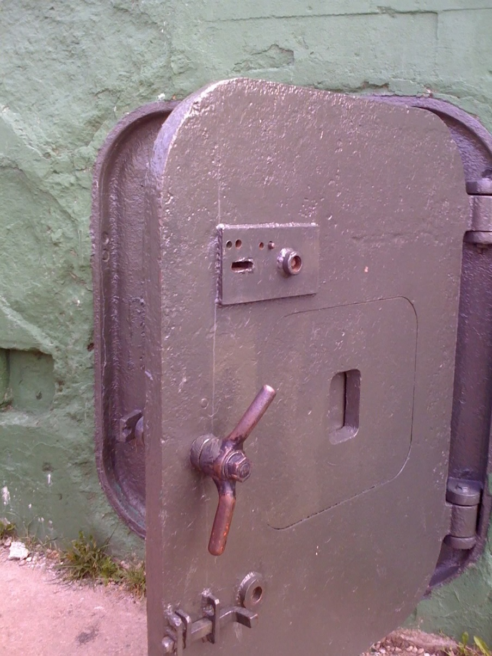
Ostwall

Slide 14
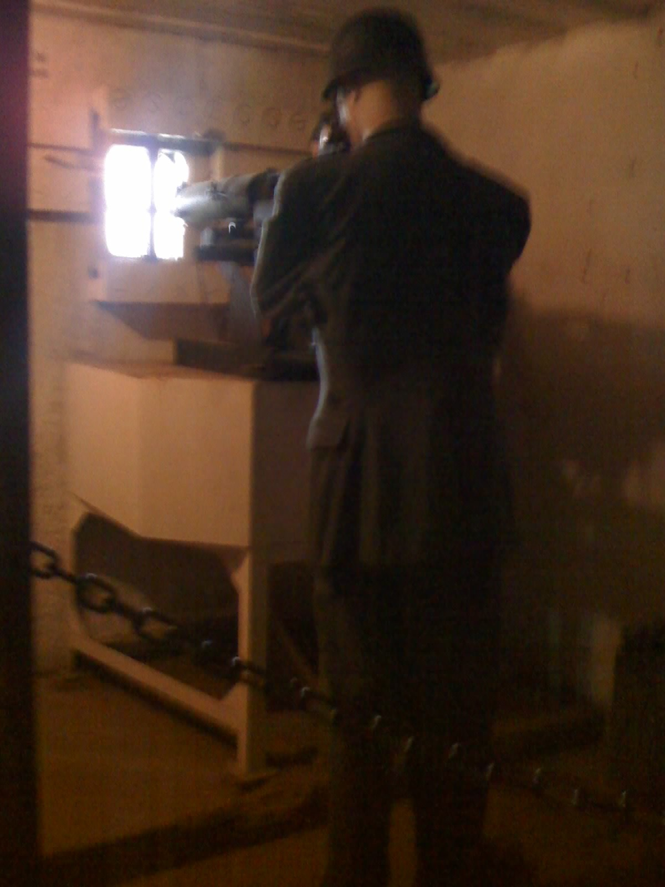

Slide 15
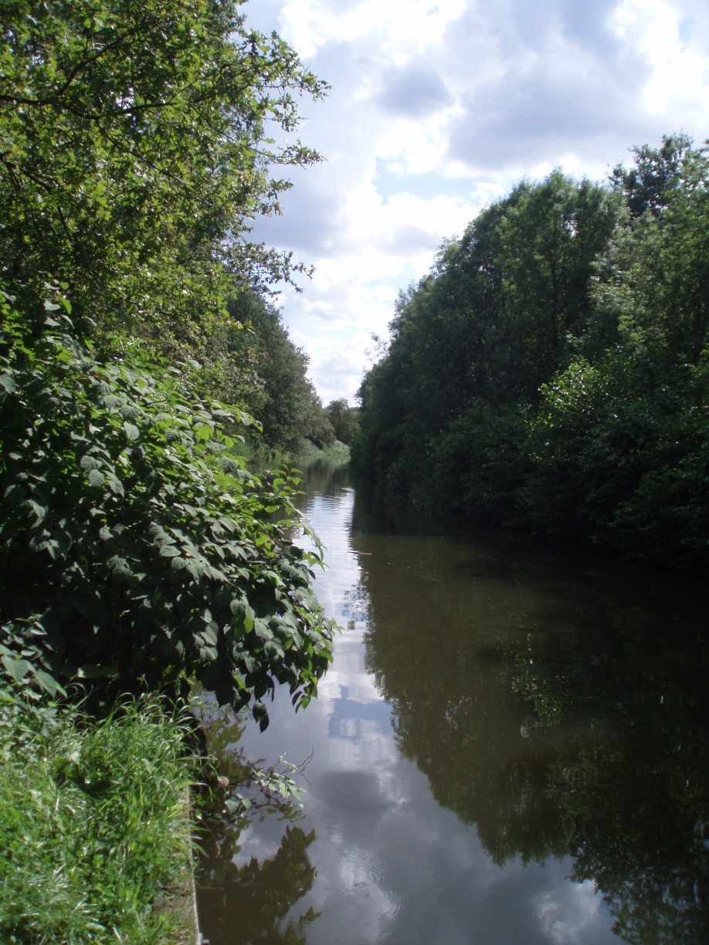
55 Years Greening

Slide 16
Local Recreation: fishing

Slide 17
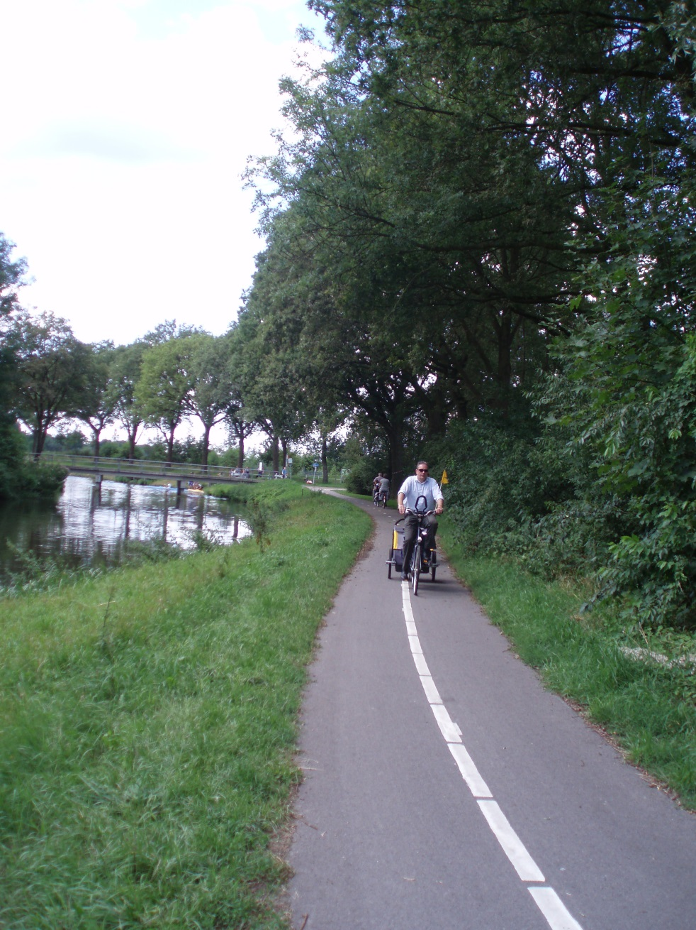
Inland tourism: Cycling

Slide 18
Walking

Slide 19
Canoeing

Slide 20
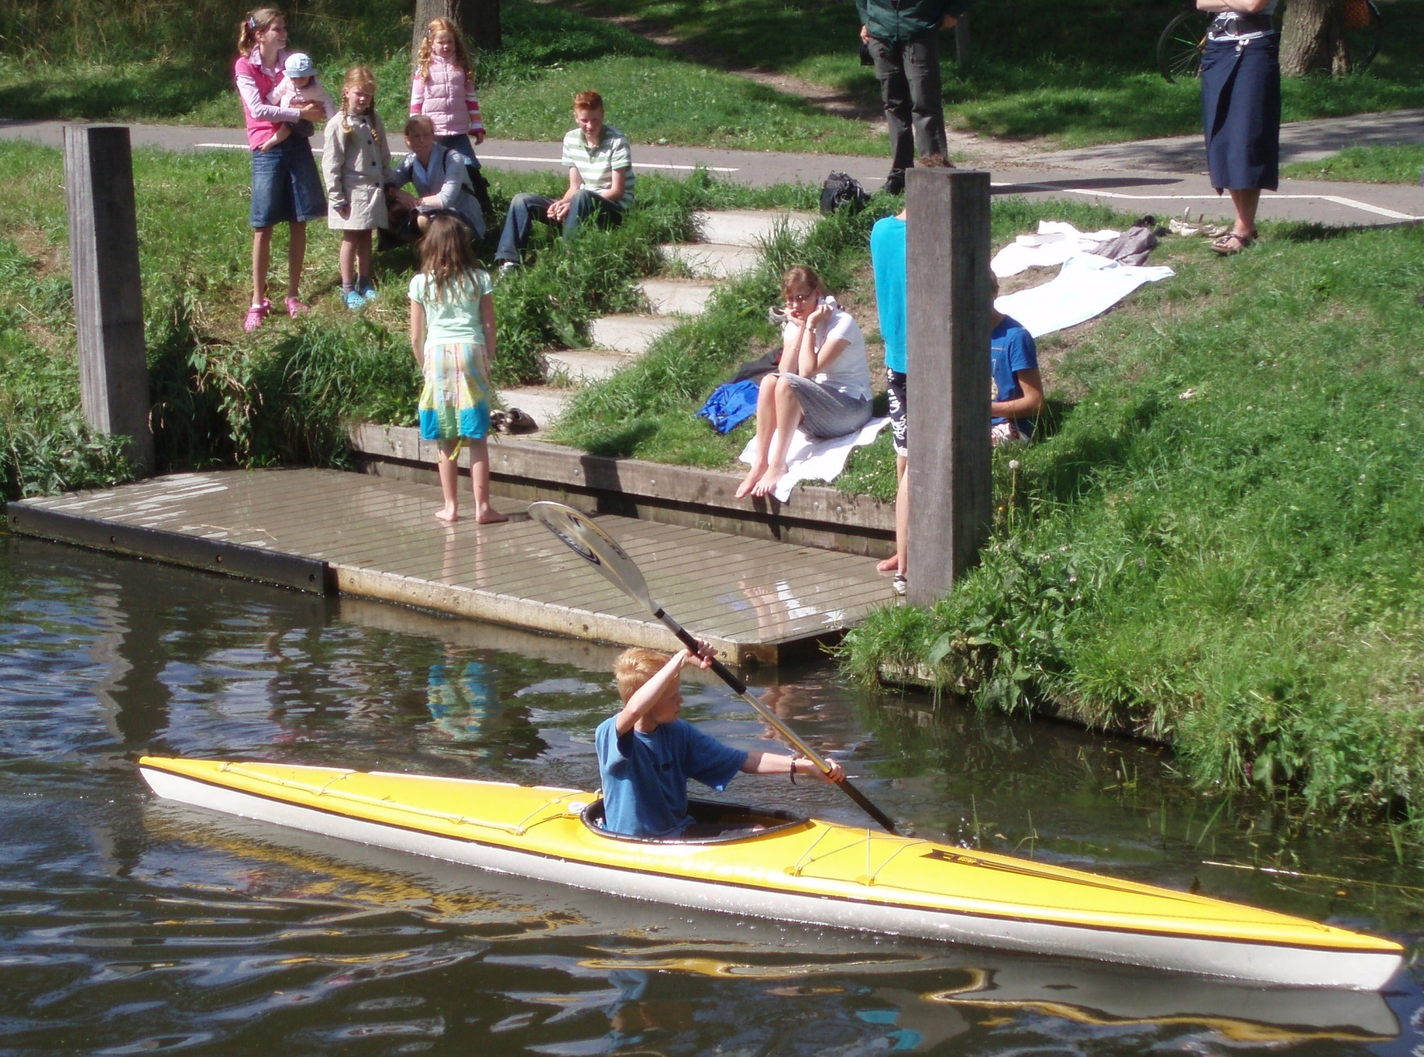

Slide 21
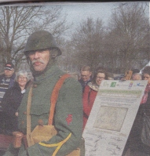
Living history

Slide 22
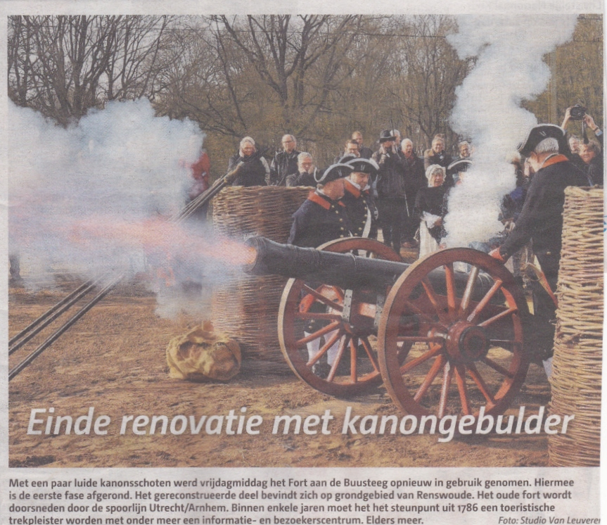
Older Living History

Slide 23
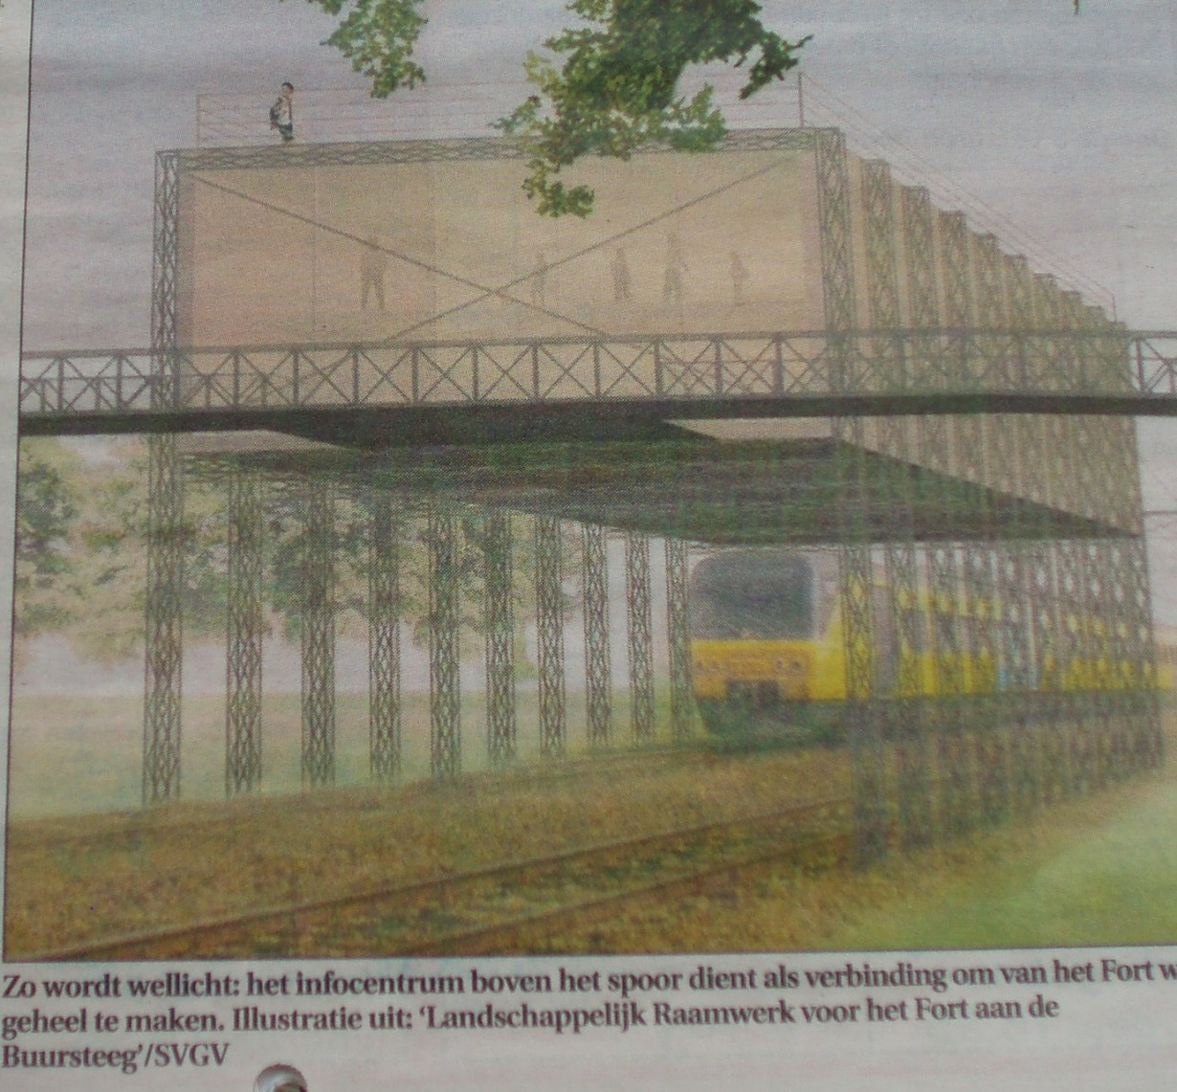
Living History alongside an old fortress

